Slide 1

WELCOME TO OUR CLASS
ENGLISH
CLASS 3D
Cao Thi Dat

Slide 2

What are you doing?

Slide 3

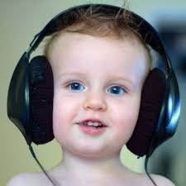
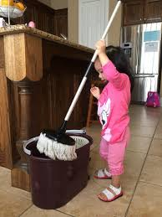
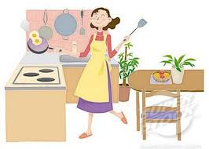
Unit 18: WHAT ARE YOU DOING?
Lesson 1
* Vocabulary
- cooking: đang nấu ăn
- reading: đang đọc sách
- listening to music: đang nghe nhạc
- cleaning the floor: đang lau sàn nhà

Slide 4

Unit 18: WHAT ARE YOU DOING?
Lesson 1
Match the word from A with the meaning from B
A | B
1. listening to music 2. cooking 3. cleaning the floor 4. reading | a. đang nấu ăn b. đang lau sàn nhà c. đang nghe nhạc d. đang đọc
* Key: 1 – c, 2 – a, 3 – b, 4 – d

Slide 5

Unit 18: WHAT ARE YOU DOING?
Lesson 1
1. Look, listen and repeat (P 52)
I’m home. Where are you, Hoa?
I’m in my room.
What are you doing?
Nam
I’m reading.
Hoa
Sentence pattern:
What are you doing?
Bạn đang làm gì vậy?
I’m reading = read+ing
(V+ing)
Tôi đang đọc.

Slide 6
Unit 18: WHAT ARE YOU DOING?
Lesson 1
2. Point and say.
a. reading
b. cooking
What are you doing?
c. listening to music
d. cleaning the floor
I’m …….

Slide 7
2. Point and say.
What are you doing?
I’m reading.

Slide 8
2. Point and say.
What are you doing?
I’m cleaning the floor.

Slide 9
2. Point and say.
What are you doing?
I’m listening to music.

Slide 10
2. Point and say.
What are you doing?
I’m cooking.

Slide 11
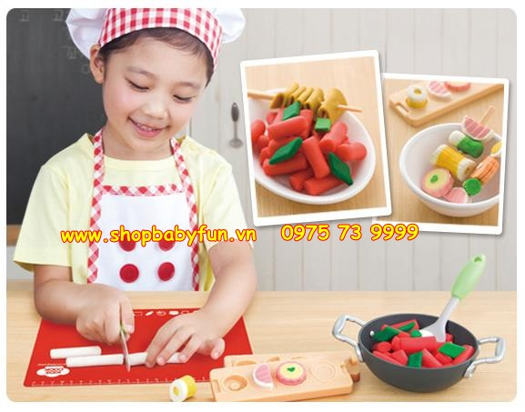
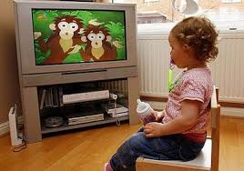
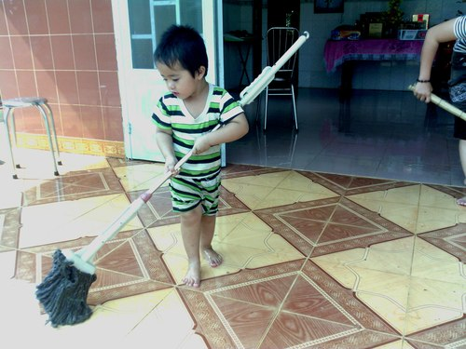
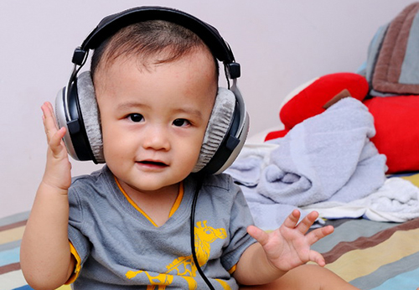
Unit 18: WHAT ARE YOU DOING?
Lesson 1
3. Let’s talk.
What are you doing?
I’m …...

Slide 12
Unit 18: WHAT ARE YOU DOING?
Lesson 1
4. Listen and tick. (p 53)
Key:
1. b
2. a
3. b

Slide 13
Unit 18: WHAT ARE YOU DOING?
Lesson 1
* Homework.
- Do exercise 5 and 6 page 53
- Learn vocabulary and sentence pattern by heart.
- Prepare next lesson.

Slide 14


